Slide 1
A Large Scale Prediction Engine for App Install Clicks and Conversions
Speaker: Ming-Chieh, Chiang
Advisor: Jia-Ling, Koh
Source: CIKM’17
Date: 2018/05/01

Slide 2
Outline
Introduction
Method
Experiment
Conclusion

Slide 3
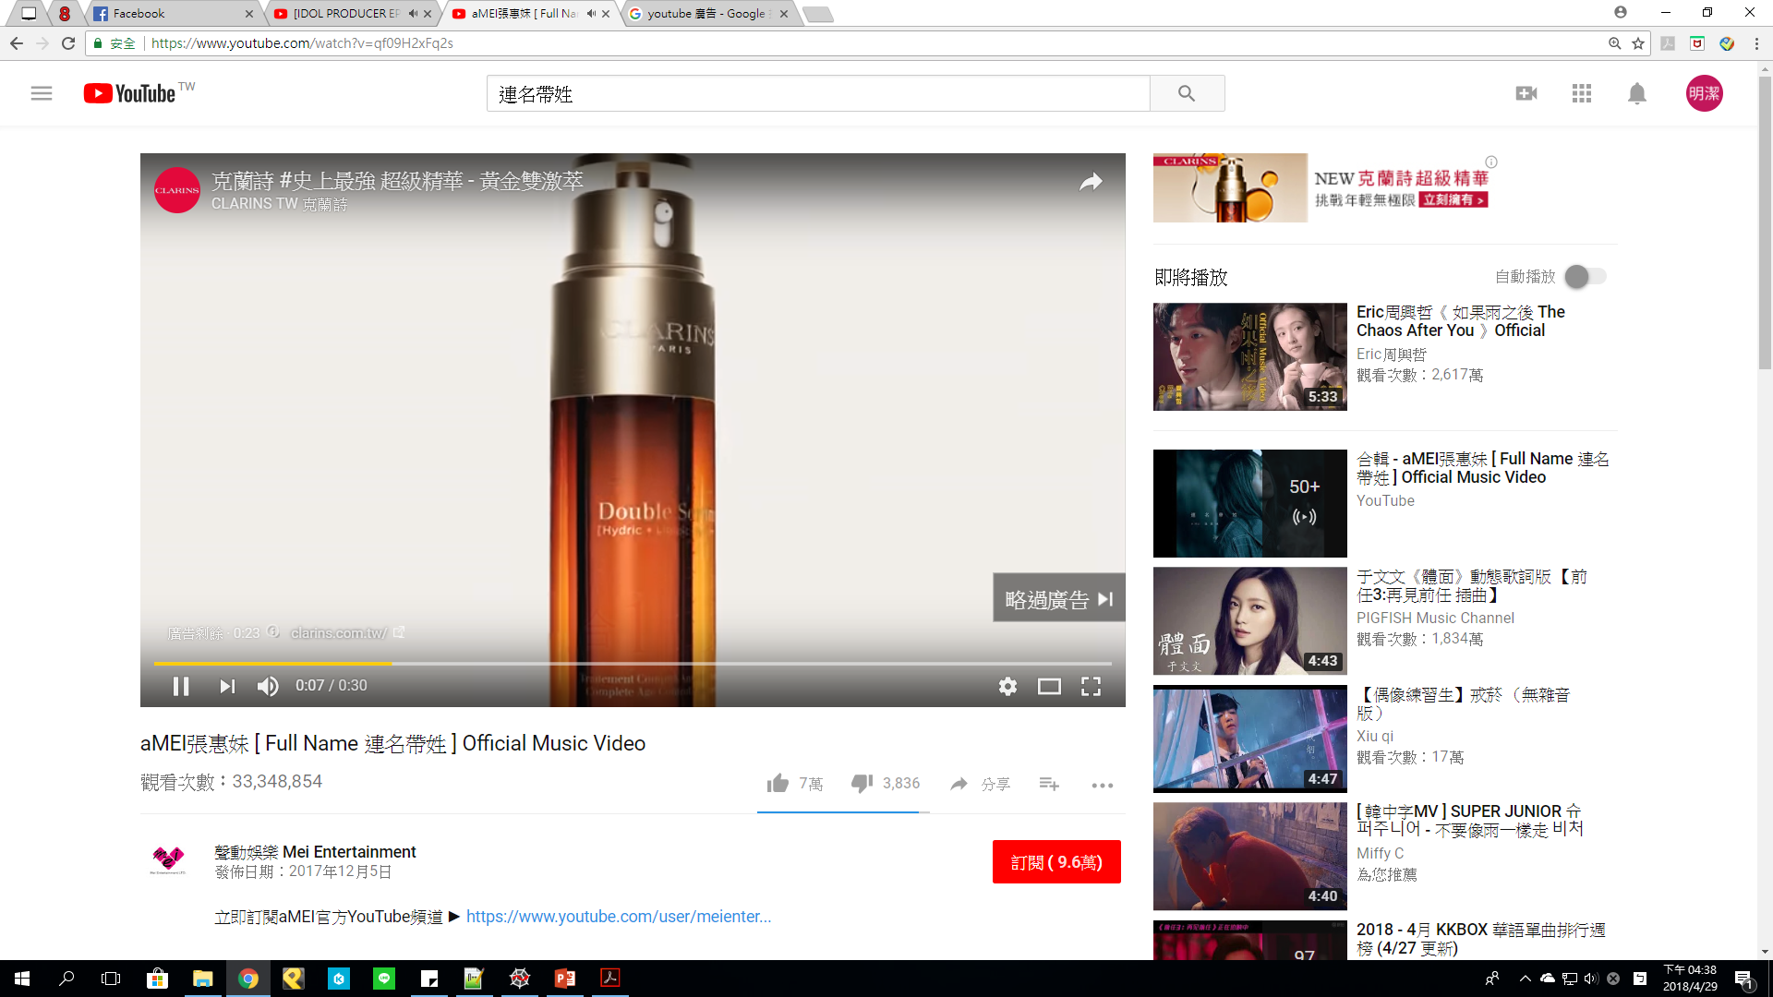
Motivation

Slide 4
Motivation

Slide 5
Goal
Built a scalable machine learning pipeline for better estimating the probability of users clicking on app install ads and the resulting conversions

Slide 6
Online Advertising Terms

Slide 7
Outline
Introduction
Method
Experiment
Conclusion

Slide 8
Framework

Slide 9
Task
Model training improvements (via sequential training)
Latency improvements (via sequential scoring)
Cross feature engineering (via deep learning and transfer)

Slide 10
Feature Engineering
Synthesized feature and binning
Cross feature

Slide 11
Cross Feature Engineering
Hand crafted cross feature
Cross feature from GBDT
Cross feature from transfer learning with multiplayer perceptrons (MLP)

Slide 12
Cross Feature from Transfer Learning with MLP

Slide 13
Cross Feature from Transfer Learning with MLP
Reverse engineering cross features from MLP

Slide 14
Training with Vanilla LR

Slide 15
Training with Vanilla LR
Sum of demand feature weights
Problem:
Feature hierarchy
Feature computation costs

Slide 16
Two-step LR

Slide 17
Two-step LR
Step-1 LR
Step-2 LR

Slide 18
Two-step LR
Combine the weights

Slide 19
Two-step Online Scoring

Slide 20
Outline
Introduction
Method
Experiment
Conclusion

Slide 21
Offline Evaluation

Slide 22
Online Evaluation

Slide 23
Outline
Introduction
Method
Experiment
Conclusion

Slide 24
Conclusion
Develop novel features to improve model performance
Sequential training and scoring resulted in a further 7% lift in conversion rate and 11% lift in revenue

